Slide 1

Using Python at the Center for High Performance Computing
Robben Migacz Scientific Consultant
Based largely on work by Brett Milash

Slide 2

Scope of this presentation
This presentation is an overview of strategies for using Python on systems at the CHPC. It is not an introduction to the Python language itself; for this, see the CHPC’s Introduction to Python series.
In this presentation, we’ll focus on running Python on the Linux clusters, which represent the majority of computational resources at the CHPC.

Slide 3

Q1
To use Python effectively at the CHPC, which version should I use?

Slide 4

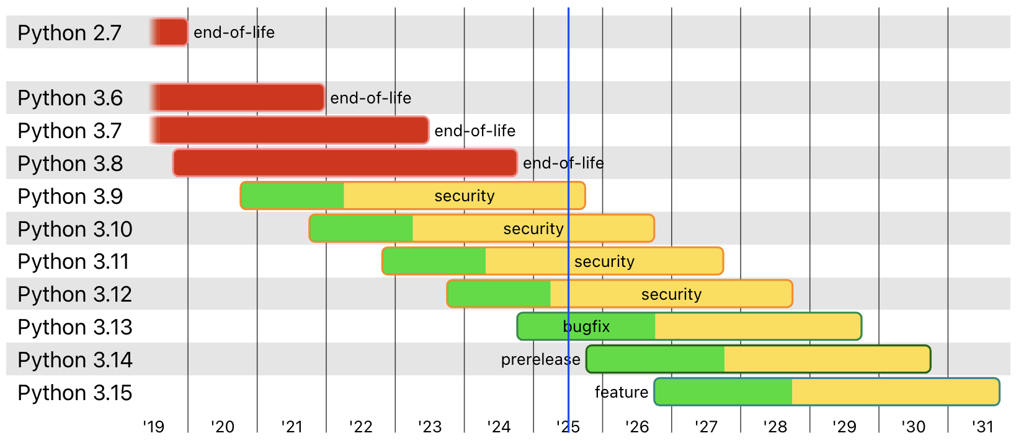
Python versions
Python versions are generally supported for five years. We recommend using a recent version when you are using CHPC systems. (We’ll discuss this soon.)
See more at https://devguide.python.org/versions/

Slide 5


Python versions
When you first log in to a CHPC system from the command line, the Python interpreters available to you are the system versions, which can be quite old. Please keep this in mind if you’re running Python from the command line.
python3 --version
Python 3.6.8
This version of Python is considered end-of-life
python2 --version
Python 2.7.18
This version of Python is considered end-of-life

Slide 6
Python versions
If you’re running Python from the command line, use a module! If you’re using Open OnDemand, you’ll be able to select a version.
module spider python
⋮
python/2.7.18 python/3.6.8 python/3.8.8 python/3.9.15 python/3.10.3 python/3.11.3 python/3.11.7-spack python/3.11.7 python/3.12.4
⋮
module load python/3.12.4
python --version
Python 3.12.4

Slide 7
Python versions
There are also Python modules with machine learning packages already installed and ready to use.
module spider deeplearning
⋮
deeplearning/2023.3 deeplearning/2024.1 deeplearning/2024.2.0 deeplearning/2025.4
⋮
module load deeplearning/2025.4
python --version
Python 3.11.11
This module loads Python with common machine learning packages.
Read more on the CHPC documentation →

Slide 8

Q2
I have specific software requirements; how do I install packages?

Slide 9


Python packages
Users can install their own packages on CHPC systems. We suggest using virtual environments or conda environments to install your own Python packages.
Photo by Luke Heibert (Unsplash License)

Slide 10
Python packages: virtual environments
Virtual environments (venv) allow users to install their own Python packages with pip. They are a built-in part of the Python language.
Use a virtual environment if all software can be installed with pip.
Read more on the CHPC documentation →

Slide 11
Python packages: conda environments
Conda environments allow users to install software in isolated environments. This includes versions of Python; Python packages; and other software, such as R dependencies commonly used in bioinformatics software.
If any dependency requires conda, use a conda environment for all dependencies.
Read more on the CHPC documentation →
Advanced users: Self-installed conda →

Slide 12

Q3
To use Python effectively at the CHPC, where should I run my scripts?

Slide 13

High-performance computing clusters
If you haven’t seen the Introduction to the CHPC presentation, we recommend viewing a recording or reading through the slides.
Here, we’ll briefly discuss the architecture of high-performance computing clusters, which is important to keep in mind when using CHPC systems.
Introduction to the CHPC presentation materials →

Slide 14

High-performance computing clusters
High-performance computing clusters are not individual computers with lots of resources. They’re composed of many computers, often called nodes.
The “front doors” to HPC clusters are login nodes, which are not suitable for large or long-running computations.
Photo by Sam Liston (CHPC)

Slide 15

High-performance computing clusters
Scheduler (Slurm)
SSH, FastX
Your computer
Login nodes Use only for development and brief testing
Compute nodes Use for large or long-running calculations

Slide 16






Presentation structure
There are many ways to use Python at the Center for High Performance Computing.
In this presentation, we’ll focus on the most effective strategies.
Command line (SSH)
FastX
Open OnDemand
Running Python on login nodes
Open OnDemand
Command line (salloc)
Batch scripts (sbatch)
Running Python on compute nodes

Slide 17
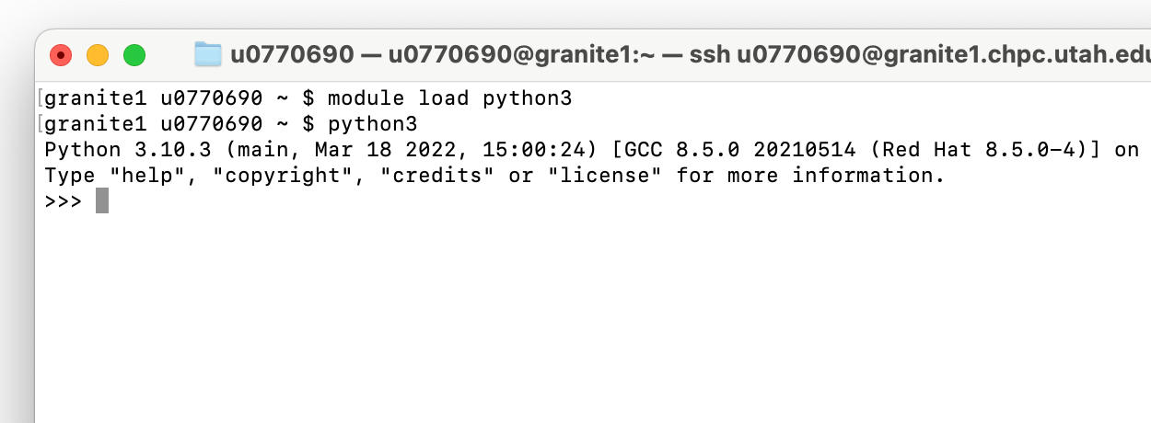
Command line (SSH)
Running Python on login nodes
You can connect to a login node with SSH, load a Python module, and run the Python interpreter to work interactively or run scripts.

Slide 18
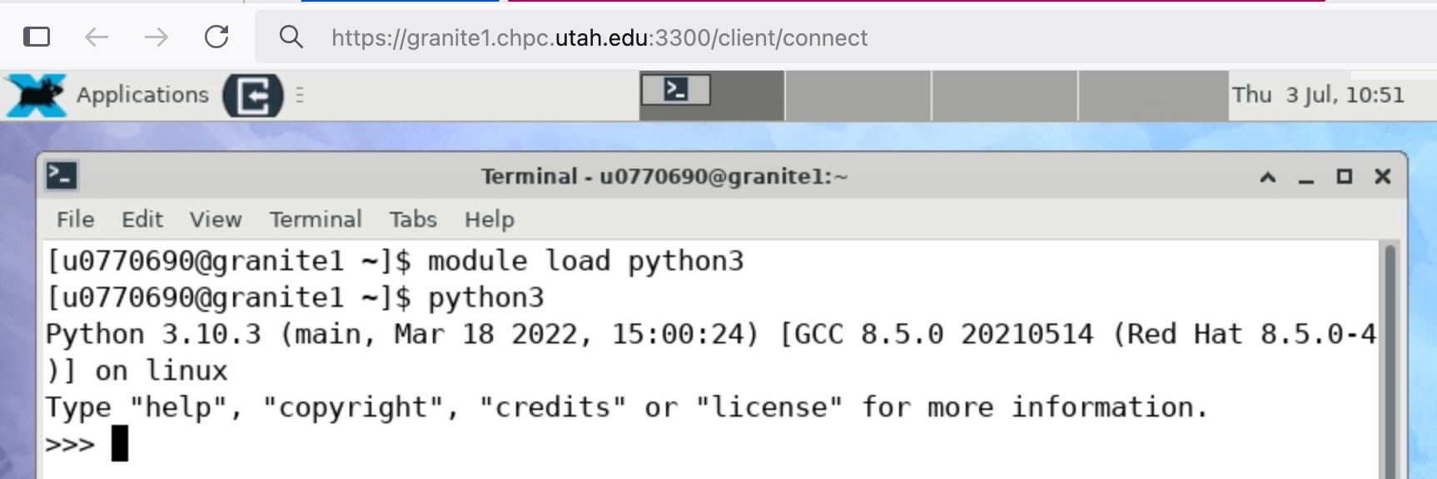
FastX
Running Python on login nodes
You can also use FastX to connect to a login node. This will allow you to work with a desktop environment and maintain persistent sessions. You can use FastX from a web browser or a client you install on your own computer.

Slide 19

Open OnDemand
Running Python on login nodes
You can use a web browser to quickly access a terminal on a login node through “Shell Access” on Open OnDemand.

Slide 20
Running Python on compute nodes
Running on compute nodes will require interaction with the scheduler, Slurm. If you’re not familiar with Slurm, we recommend reading through our documentation and attending the introductory Slurm presentations.
Read more on the CHPC documentation →
Information about presentations →

Slide 21
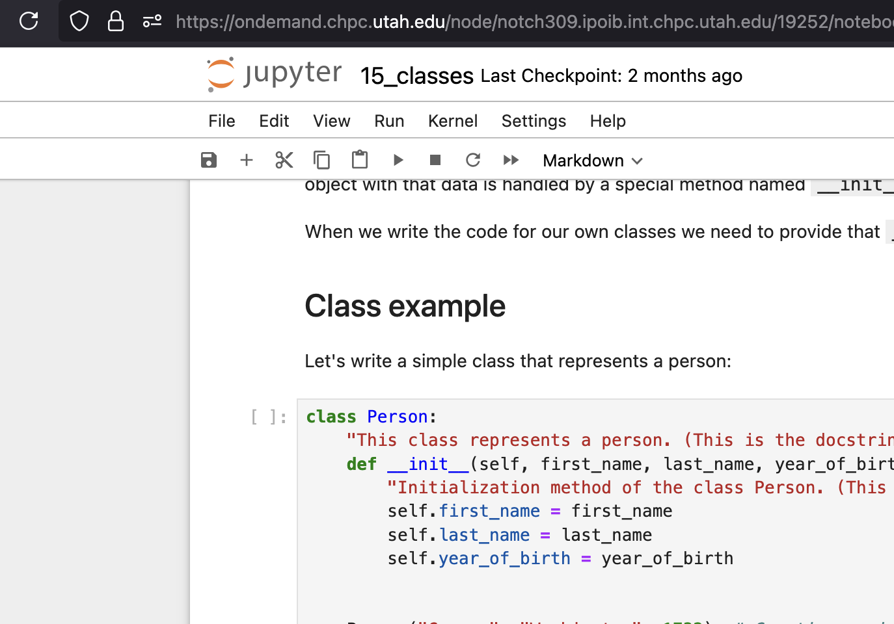
Open OnDemand
Running Python on compute nodes
Open OnDemand allows you to start jobs on compute nodes from your web browser. We recommend using Jupyter Notebooks in Open OnDemand if you are using Python interactively.

Slide 22
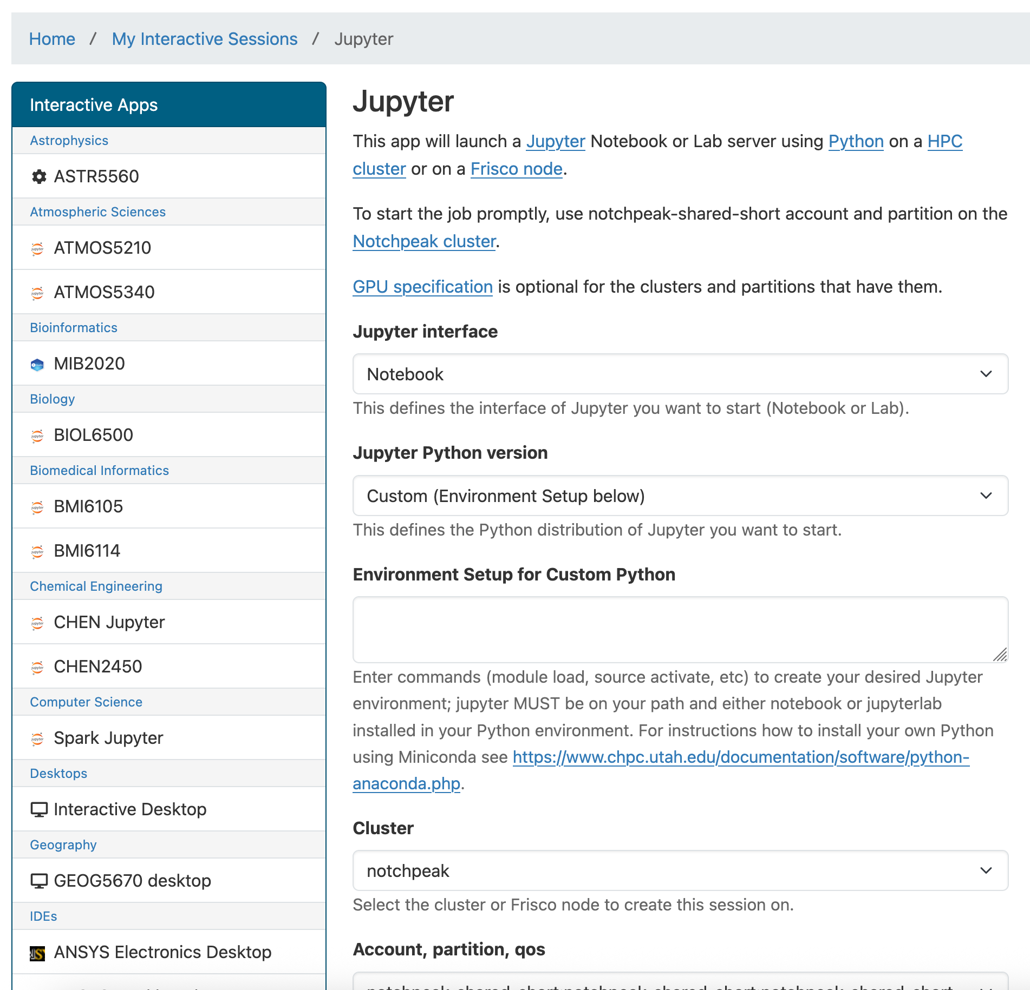
Open OnDemand
Running Python on compute nodes
Open OnDemand allows you to start a Slurm job by selecting parameters from a menu.
If you are using a virtual environment or conda environment with a Jupyter Notebook, make sure you choose the “Custom” Python version. Enter the commands you’d use to access your environment in “Environment Setup.”
The “jupyter” package must be installed in your environment for this to work.

Slide 23
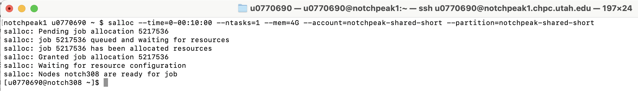
Command line (salloc)
Running Python on compute nodes
You can use the “salloc” command to request computational resources from the command line on a login node.
Watch for a change in your prompt when resources are allocated.
Login node
Compute node
Once you are on a compute node, you can load and run Python without worrying about resource consumption

Slide 24
Batch scripts (sbatch)
Running Python on compute nodes
You can use the “sbatch” command to submit a script that will run on a compute node once resources are available. This is the best way to run Python scripts that do not require user interaction.
slurm_script.sh
Slurm job parameters
#!/usr/bin/env bash
#SBATCH --time=0-00:10:00
#SBATCH --ntasks=1
#SBATCH --mem=4G
#SBATCH --clusters=notchpeak
#SBATCH --account=notchpeak-shared-short
#SBATCH --partition=notchpeak-shared-short
module load python3
python3 my_script.py
sbatch slurm_script.sh

Slide 25

Summary of strategies for using Python effectively at the CHPC

Slide 26
Strategies for running Python on login nodes
 | Mechanism for running Python
Mechanism for accessing CHPC resources | Interactive (command line) | Script | Jupyter Notebook | Remote Editing (VSCode and others) | Workflows (Snakemake and others)
SSH (graphics support with X forwarding) | ✦ Ideal | ✦ Ideal | ✗ Not recommended | ✗ Not recommended | ✦ Ideal
FastX (graphics support in desktop sessions) | ✦ Ideal | ✦ Ideal | ✓ Possible (in web browser on remote host) | ✗ Not recommended | ✦ Ideal
Open OnDemand (Shell Access) | ✓ Possible (lacks support for graphics) | ✓ Possible (lacks support for graphics) | ✗ Not recommended | ✗ Not recommended | ✓ Possible (lacks support for graphics)

Slide 27
Strategies for running Python on compute nodes
 | Mechanism for running Python
Mechanism for accessing CHPC resources | Interactive (command line) | Script | Jupyter Notebook | Remote Editing (VSCode and others) | Workflows (Snakemake and others)
Batch jobs: sbatch (from login node) | ✗ Not recommended | ✦ Ideal | ✗ Not recommended | ✗ Not recommended | ✦ Ideal
Interactive jobs: salloc (from login node) | ✦ Ideal | ✓ Possible (if no user interaction is necessary, use a script instead) | ✗ Not recommended | ✓ Possible (start a job, then connect to the compute node from your local computer¹) | ✓ Possible (workflows often work well as scripts, for which a batch job may be more appropriate)
Open OnDemand (Interactive Apps or Job Composer) | ✓ Possible (use Interactive Apps → Interactive Desktop, then run Python) | ✓ Possible (use Jobs → Job Composer to submit a job as you would from the command line) | ✦ Ideal (Interactive Apps → Jupyter) | ✓ Possible (start a job with Jobs → VSCode Server, then connect to the compute node from your local computer¹) | ✗ Not recommended
¹This will require using an SSH tunnel, as described on the Visual Studio Code documentation on the CHPC website

Slide 28


Do you have any questions?
If we don’t have time to answer your question, or if you think of any questions after the presentation, please reach out to us! helpdesk@chpc.utah.edu

