Slide 1

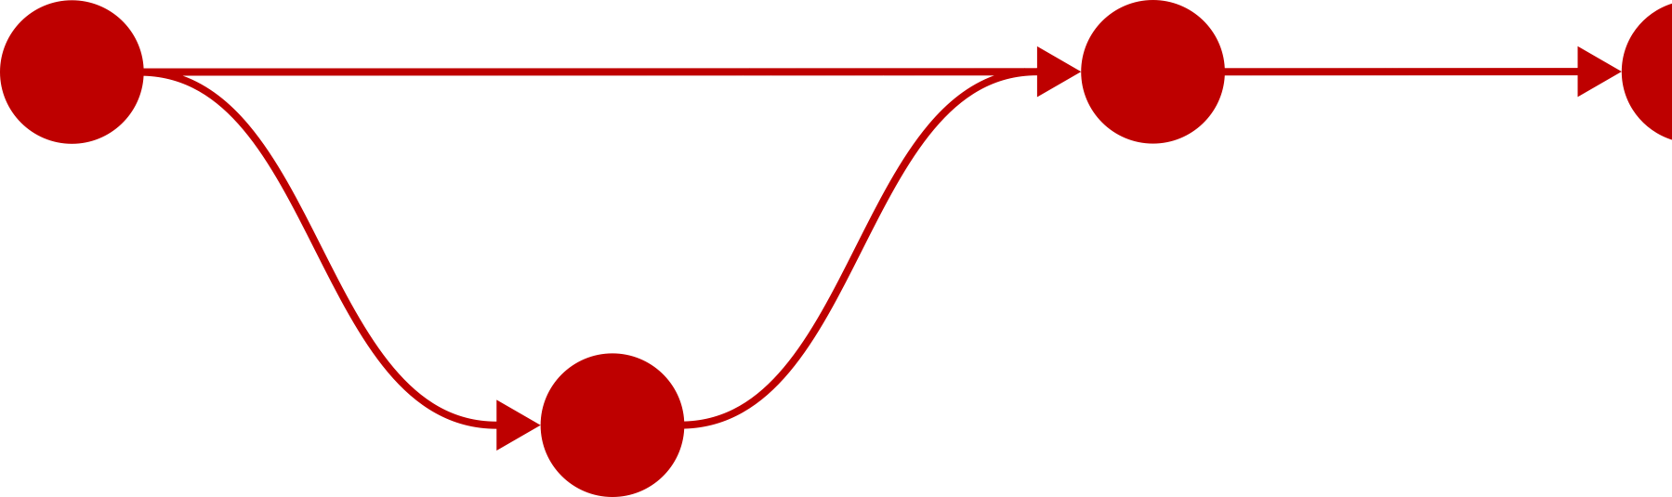

Introduction to Git
Presented by
Robben Migacz

Slide 2


Please note
We won’t be doing anything too complicated, so you can probably follow along even if you don’t have experience using the command line
We will be using Git from the command line. If you are not familiar with the basics of navigating the Linux command line (e.g., cd, ls, a text editor), we recommend going through our introductory Linux training sessions first.

Slide 3
Please note
You can use Git from the command line on the Center for High Performance Computing’s Linux resources (the clusters). If you do not have a CHPC account, however, please download Git so you can follow along.

Slide 4
Installing Git
Windows: Download Git for Windows from your browser
macOS:
Run git from the Terminal application, which will prompt you to install it
Alternatively, Git is also available through Homebrew or MacPorts
Linux:
Use Git on CHPC resources with module load git
sudo apt install git (Debian, Ubuntu, Linux Mint, etc.) or sudo dnf install git (Red Hat Enterprise Linux, Fedora Linux, Rocky Linux, etc.)
… or get Git via Git: git clone https://github.com/git/git
?
?

Slide 5
What is Git?
Git is version control software. It helps you keep track of different versions of your files.

Slide 6
What is Git?
Git is version control software. It helps you keep track of different versions of your files.
my_file
my_file_2
my_file_3
my_file_fixed
Does this look familiar?
Consider using Git to manage versions!
my_file_final
my_file_final_ final
my_file_FINAL

Slide 7
What is Git?
Git is version control software. It helps you keep track of different versions of your files. This is particularly helpful when you are working on a project with other people, as it can help your team stay organized.

Slide 8
What is Git?
Git is not the same thing as GitHub. The two are often conflated by new users. GitHub is a web platform that is used to store, share, and work on Git repositories. (Learning Git will help you understand GitHub, so don’t close the window just yet if this isn’t quite what you were expecting.)
Git is open-source software. It is not owned or maintained by GitHub. As of Fall 2024, its source code has more than 1,700 contributors.

Slide 9
Who uses Git?
Git is used primarily by software developers.

Slide 10

Who uses Git?
Developers who should probably start using Git
Git is used primarily by software developers.
In the Stack Overflow Developer Survey 2021, more than 93% of respondents said they use Git.

Slide 11
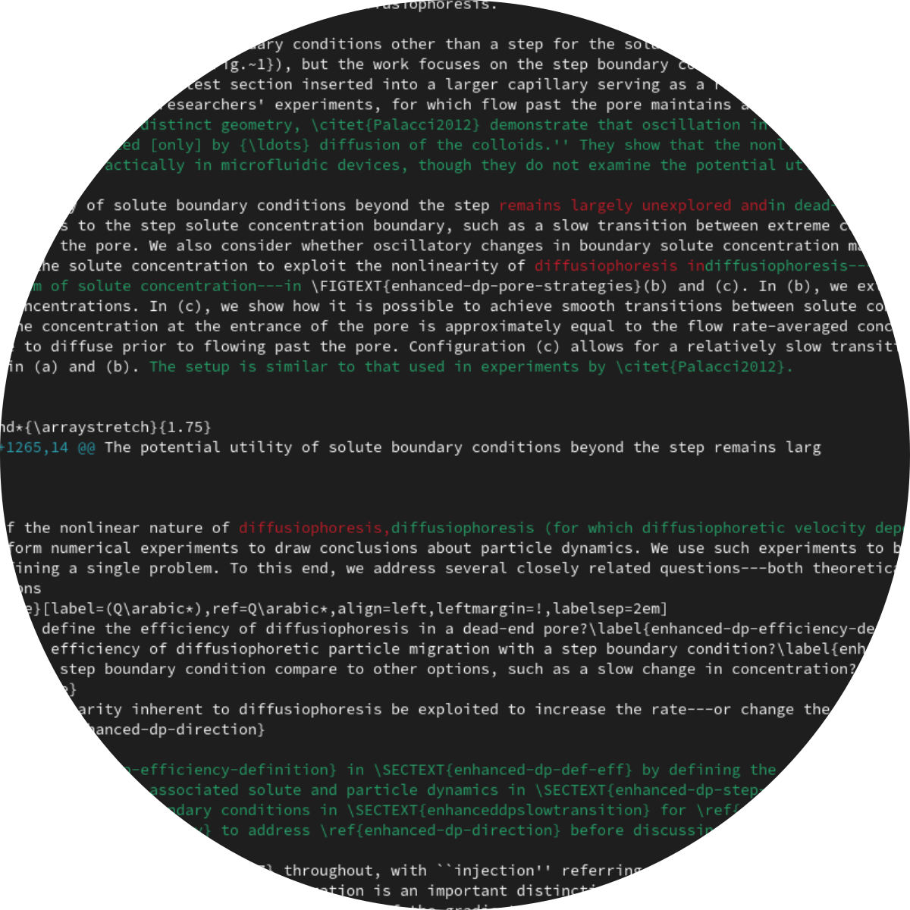
Git isn’t just for software developers
However,
Git will help you keep track of changes to any of your files. It works best with plain text (anything human-readable in a text editor) and relatively small files.
It works well with LaTeX documents, for example.

Slide 12

Let’s learn how to use Git!

Slide 13

Quotation about Git
Git … frustrates me because, while it is an excellent productivity tool that lets scores of developers collaborate on a single code base without clobbering each other, it asks its users to understand how it works at its deepest levels. It’s like if you were going to write a letter and first had to read a treatise on UTF-8 encoding.
— Sharon Cichelli, “Git is a Directed Acyclic Graph and What the Heck Does That Mean?”, 2017

Slide 14

Introduction to presentation format
We’ll need to cover some terminology before we can move into the hands-on material.
Git can be difficult to understand at first; taking a step back to see the big picture will help when we start looking at commands.

Slide 15

Terminology: Repository
A repository is where the revision history of a project is stored. It’s a hidden directory, .git, within the directory your project resides in.
The .git directory’s name starts with a period, which means it’s “hidden.” Depending on your file browser’s settings, you may not be able to see it. You probably won't need to; we’ll use commands to interact with the repository.
Just know that your project history doesn’t live in a mysterious database or “in the cloud.” It’s just a collection of files in the same directory as your project.

Slide 16
Terminology: Repository
There are a few important things to note about repositories:
If you delete the .git directory, you lose your project history (and you are stuck with the current state of your files)
If you make a backup copy of your project directory, you also make a backup copy of your Git repository (contained within the project directory)
We always recommend backing up your important files!
If you send your project directory, including .git, to another person, the other person can see your project history
You should avoid storing sensitive information or passwords in a Git repository, especially if there is a possibility that you might share your work with others or use a host like GitHub

Slide 17
Terminology: Commits
Git does not keep track of every change you make; it is not the same as having an undo button or a file history. Instead, you commit changes as you see fit.

Slide 18
Quotation about Git and snapshots
With Git, every time you commit, or save the state of your project, Git basically takes a picture of what all your files look like at that moment and stores a reference to that snapshot.
— Pro Git (2nd Edition), Scott Chacon and Ben Straub, 2014
Notes:
Note that the Pro Git book is free; it is available on the Git website

Slide 19
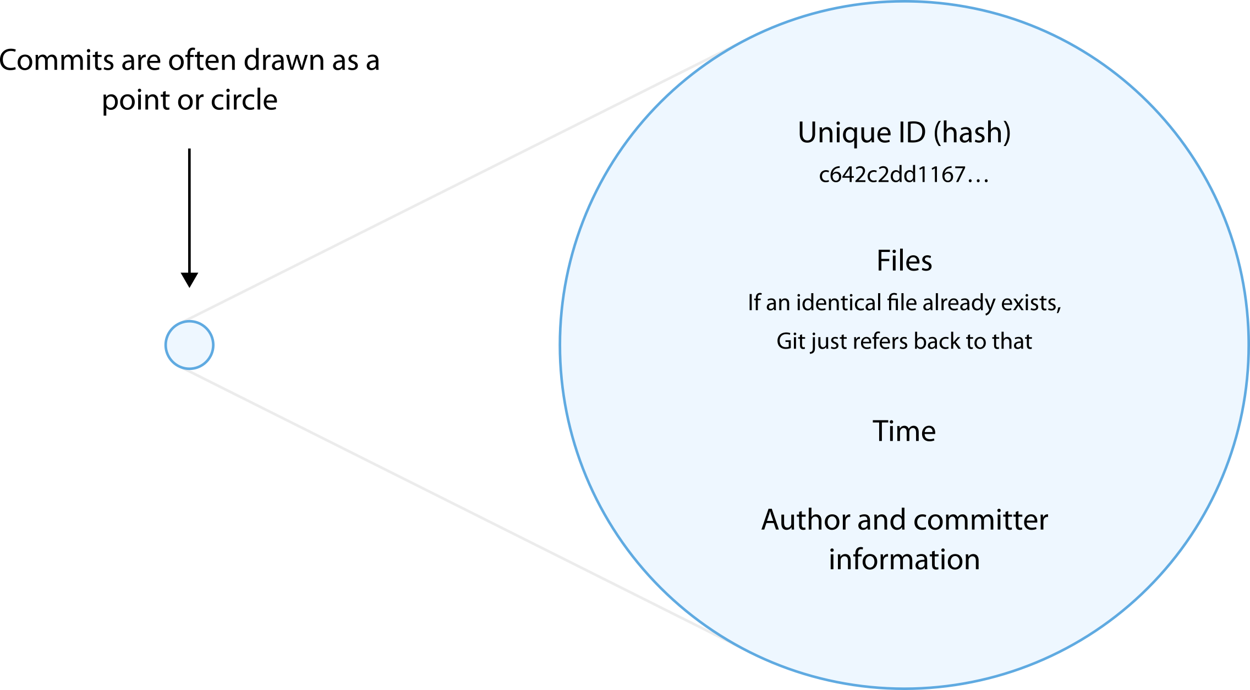
Terminology: Commits
Commits have metadata such as the committer, the author (usually the same as the committer, but not always), the time, and a message describing the changes.
Every commit has an associated hash, which is the name of the commit according to Git. This is how you reference a specific commit. You can truncate (shorten) the hash in commands.

Slide 20



Terminology: Working tree and staging area (index)
Before you can make a commit, you need to tell Git which changes you want it to keep track of. You first work on files in the working tree. You then move files with changes you want to commit to the staging area or index. Only changes in the staging area are included in commits.
Local repository (commits)
Working tree
Staging area
add
commit

Slide 21

Terminology: Graph
Together, commits form a (directed acyclic) graph.
Graph: Commits (vertices) are related (connected by edges)
Directed: Commits refer back to other commits (earlier versions); there is a direction inherent to relationships between commits
Acyclic: If you follow the graph from a commit, that commit will not appear again; it cannot be its own “parent” (no matter how many generations removed)
In other words, a version of your project cannot be based on itself
There are no loops in the graph
Notes:
Comment on direction of arrow: points backward relative to time

Slide 22
Let’s apply these concepts and start using Git!

Slide 23
In practice: Getting help
Git comes with documentation that can help you learn more about each command. To get help with git commit, for example, run
git help commit
Additionally, there are a few built-in tutorials and a glossary:
git help tutorial git help everyday git help workflows git help glossary

Slide 24
In practice: Repositories and configuration
You can initialize a Git repository in any directory by running
git init
You can configure your username, email address, and preferred text editor with git config.
git config --global user.name "Your Name"
git config --global user.email "your.name@your.domain" git config --global core.editor "nano"
Notes:
Use nano for the sake of others who haven’t used the command line much in the past

Slide 25

In practice: Repositories and configuration
You can initialize a Git repository in any directory by running
git init
You can configure your username, email address, and preferred text editor with git config.
git config --global user.name "Your Name"
git config --global user.email "your.name@your.domain" git config --global core.editor "nano"
--global sets a default value; you can omit it to apply a configuration to the current repository (but not other repositories)

Slide 26

Hands-on: Repositories and configuration
Create a new directory and initialize a Git repository in it
Configure your name, email, and text editor through Git
Run git status to check that the repository exists This command will show you which files are in the staging area and which have been modified in the working tree.

Slide 27


In practice: Commits
You need to add files to the staging area before you commit changes.
git add filename git add *.py git add . git add --all
You can remove files from the staging area with
git rm --cached filename

Slide 28
In practice: Commits
Once you have added your changes to the staging area, you can create a new commit with
git commit
This will open a text editor for a commit message. Alternatively, use
git commit -m "Your message here"
to specify a message without opening a text editor.

Slide 29
In practice: Logs and differences
Once you’ve committed your changes, you can see them in the log:
git log --graph --all
Additionally, you can compare two different project states:
git diff earlier-commit later-commit git diff --word-diff=color earlier-commit later-commit
Without earlier-commit and later-commit, this will compare the current state to the previous commit.

Slide 30
Hands-on: Commits
Create a file in your project directory
Add your file to the staging area with git add
View the repository status with git status
Create a commit with git commit

Slide 31
Hands-on: Commits
Create a file in your project directory
Add your file to the staging area with git add
View the repository status with git status
Create a commit with git commit
Modify your file
Repeat (2), (3), and (4)
Use git log to see what your project history looks like; try a git diff between commits

Slide 32
Terminology: Distributed version control
Git is a distributed version control system. Everyone working on the project has a copy of the repository. There is no (required) single source of truth or central server.
Everyone can always edit every file. Git makes no effort to prevent users from modifying the same parts of the project at the same time (often limited by needing to “check out” and “check in” files with a central server in other version control systems). Instead, users may need to manage conflicts. This isn’t as chaotic or scary as it sounds, though!

Slide 33
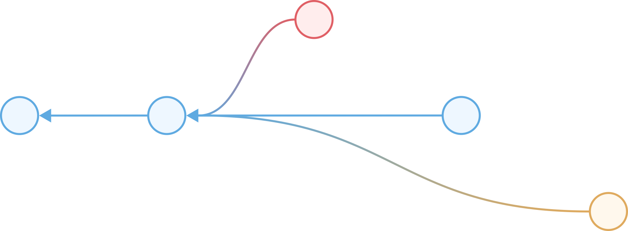
Terminology: Branches
Branches allow a project to progress in different, independent directions. In practice, the graph is rarely a straight line.
Software developers often use branches for new features, which they subsequently merge into the main branch. This way, the main branch remains stable while developers are working on substantial changes.

Slide 34
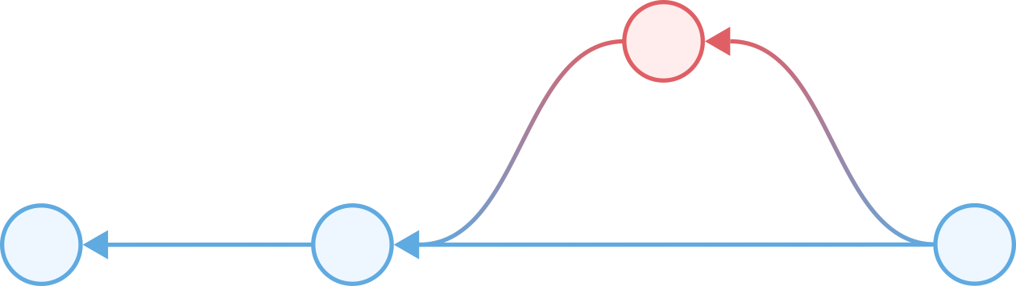
Terminology: Merges and rebases
A merge combines commits from two or more branches into a new commit on a specific branch.

Slide 35

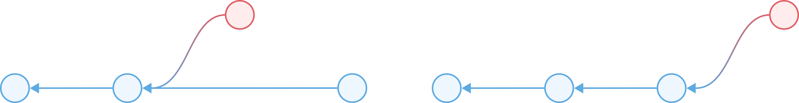
Terminology: Merges and rebases
A rebase will change the parent of a commit. It also allows you to combine or modify commits.
Since it can edit the history of a project, rebasing is not recommended if you’ve already shared your commits with others (on a remote repository, for instance). We will not cover rebasing in the hands-on portion; we’ll use merges when working with multiple branches.

Slide 36
Terminology: Conflicts
Conflicts can occur in several situations when you’re using Git. They’re a normal part of using Git and not an indication that you’ve done something wrong (the conflict is between versions, not between people!). They help prevent you from losing information or overwriting someone else’s work.

Slide 37
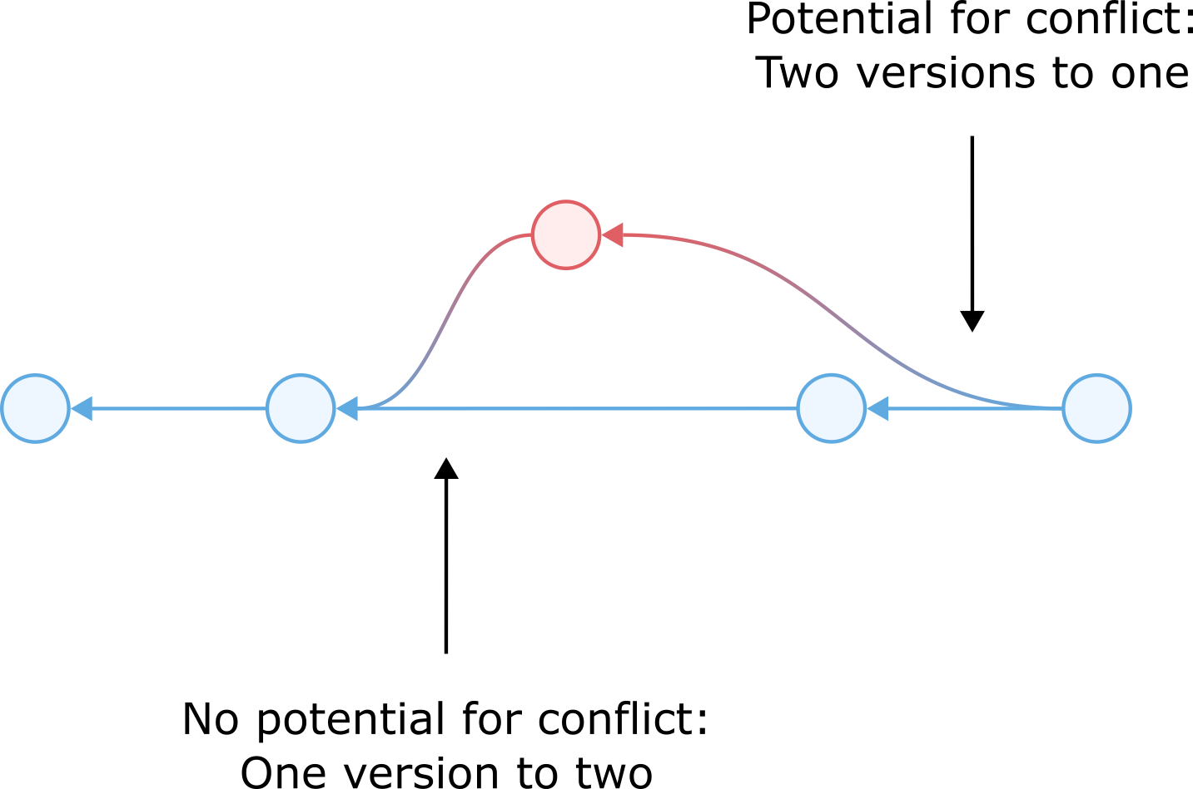
Terminology: Merges … and conflicts
When merging branches, you can encounter conflicts if the parent commits have modifications to the same parts of the project. Git has no way of knowing which (if any) is the authoritative or correct version.
Hello,
Utah!
Hello,
world!
?
Hello,
Utah!
Hello,
SLC!
Hello,
SLC!

Slide 38

Continuation of merges and conflicts
You can merge multiple branches at the same time.
Terminology: Merges … and conflicts
When merging branches, you can encounter conflicts if the parent commits have modifications to the same parts of the project. Git has no way of knowing which (if any) is the authoritative or correct version.
This is sometimes called an “octopus merge.” Some Git users prefer to merge branches sequentially to reduce the number of conflicts that need to be addressed at a time.
Hello,
Utah!
Hello,
world!
?
Hello,
Utah!
Hello,
SLC!
Hello,
SLC!

Slide 39

Terminology: Merges … and conflicts
A merge with a conflict will result in text being added to the files with conflicts. Git will add both versions to the file on separate lines so you can pick one or write something new in their place. Once you’ve resolved all conflicts, you can create a new commit.
<<<<<<< HEAD Hello, SLC! ======= Hello, Utah! >>>>>>> other_branch
We’ll talk about this later!

Slide 40
In practice: Branching and merging
To check which branch you’re on, run git branch, which will list branches and show an asterisk * next to the current branch.
To create—and switch to—a new branch, use
git switch -c new_branch_name
To switch to an existing branch, use
git switch other_branch_name

Slide 41
In practice: Branching and merging
To merge, switch to the branch you want to merge into (the destination branch) and run
git merge some_other_branch
New users sometimes forget which branch they should be on when merging. The branch you are on when you perform the merge is the branch to which the new commit will be added. Think of a merge as an extension of git commit.

Slide 42
Hands-on: Branches and merges
Create a new branch (and switch to it)
Edit your files and commit your changes
Switch back to your other branch (how do you get a list of the names of branches?)
Perform a merge to incorporate changes you made in your new branch
Can you cause (and resolve) a merge conflict?

Slide 43
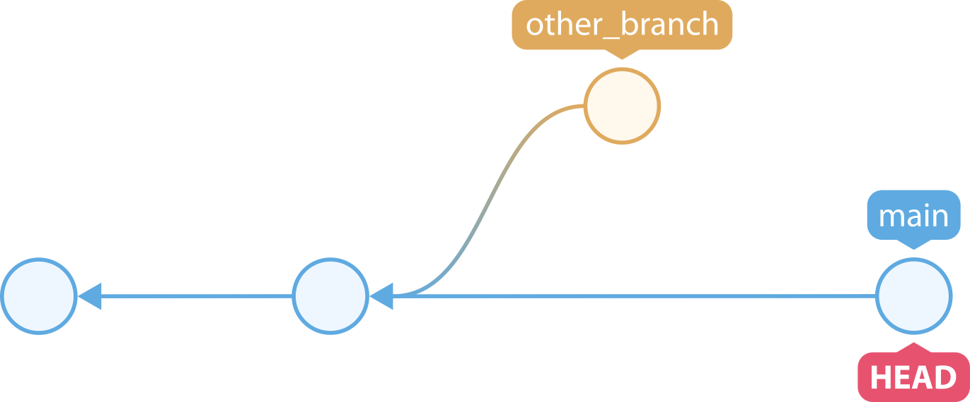
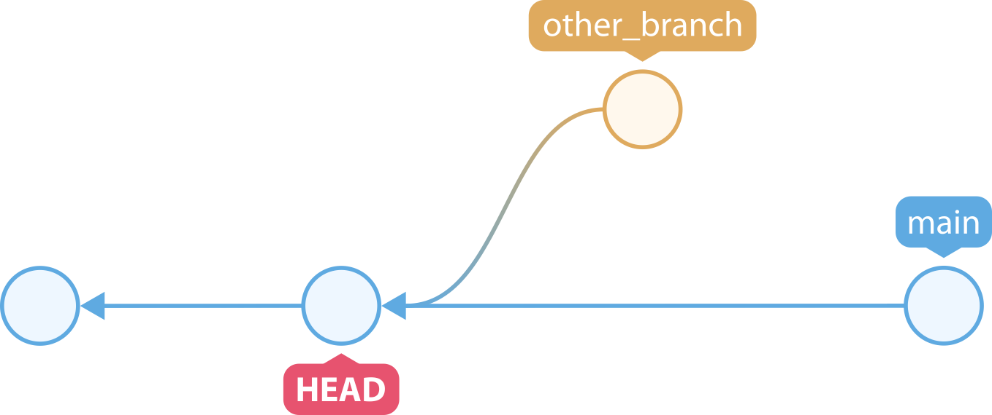
Terminology: References and HEAD
We’ve been using the names of branches in commands. These are references to specific commits. Branch references refer to the tip (the most recent commit) of a branch. This may also be called the head (not to be confused with the HEAD).
We also saw HEAD earlier. HEAD refers to the current commit: the one we’re looking at right now. Usually, HEAD is a head (the tip of a branch), but we can move it anywhere we want to look at or work on files as they were at that commit. This is called a “detached HEAD.”
Typical: Working at the tip of a branch
Detached HEAD: Working on top of a specific commit

Slide 44

Terminology: References and HEAD
Remember that, according to Chacon and Straub (Pro Git), “Git basically takes a picture of what all your files look like” when you make a commit.
If your commits are a series of pictures, HEAD is the one you’re looking at (working on) right now.
Image credit: Girl with red hat on Unsplash
Unsplash License

Slide 45
Terminology: Reverting and resetting
References are an important concept as we start discussing reverting and resetting. While I mentioned that Git is not the same as having an undo button, sometimes you do want to undo changes.
There are a few different strategies for this. Before we get into the different options, it’s important to note that nondestructive operations are always preferred if you are working with other people (if you’ve shared your repository). In other words, actually deleting information should be done sparingly—preferably before you update a remote repository or send your files to someone.

Slide 46
Terminology: Reverting
Reverting is a nondestructive option to undo changes. Reverting always creates new commits; it does not remove anything from the project history.
There are a few quirks that you should be aware of before you start reverting. Please refer to the handout for more information.

Slide 47
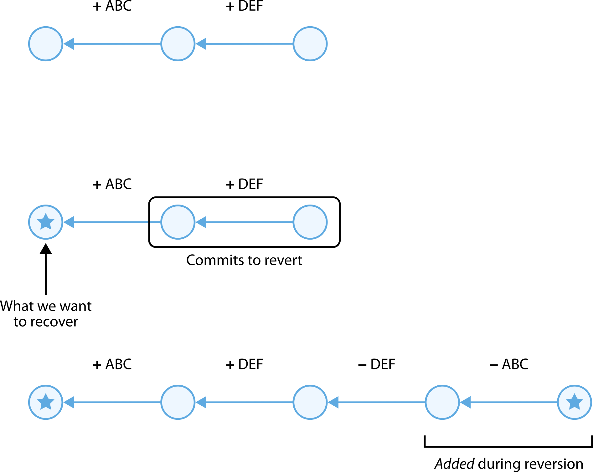
Terminology: Reverting

Slide 48
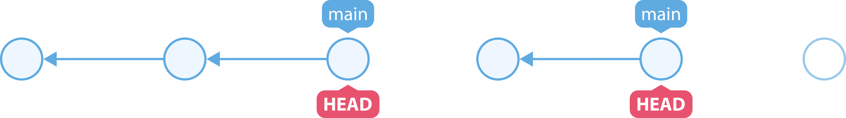
Terminology: Resetting
Resetting can be a destructive option to undo changes. It works by moving the branch reference (and HEAD).
This can “orphan” commits (it doesn’t actually delete them). If you accidentally reset, you may be able to recover your commits. They will, however, be deleted when Git performs garbage collection.
There are a few quirks that you should be aware of before you start resetting. Please refer to the handout for more information.

Slide 49
In practice: Checking out, reverting, and resetting
To work “on top of” a specific commit, use
git checkout some-commit
To revert, use
git revert some-commit
See handout for more information; this only operates on one commit unless you specify a range
To reset, use
git reset some-commit
See handout for more information; this can be --hard, --mixed (default), or --soft

Slide 50
Hands-on: Branches and merges
Create a new commit; run a git diff on the last two commits
revert your new commit; run a git diff on the last two commits
checkout a previous commit (how do you see previous commits?)
Make a new branch (and switch to it)
Create a new commit, then run git log --graph --all

Slide 51
Terminology: Remote repositories
Remote repositories are Git repositories that are not local to your computer. They’re often hosted on platforms like GitHub or GitLab.
You can interact with remote repositories with
git clone to copy a remote repository to your own computer
git remote to configure a remote repository’s information locally
git fetch to get changes from a remote repository
git pull to get changes from a remote repository and merge them into your local repository
git push to upload changes from your local repository to a remote repository
See the handout for more information.

Slide 52
Terminology: Remote repositories
Remote repository hosts often add features that are not a part of Git itself. These include such features as
Issues, which allow users to ask questions or report problems
Pull requests, which allow users to suggest changes
These are important when working with others; generally, only a limited set of users is allowed to write to the repository itself
Other users first make a copy, then make changes on their copy, then suggest the changes to the maintainers of the original repository
Continuous integration and continuous delivery (build and test suites that run every time the repository is updated)
Machine learning-driven security reviews (a recent development)

Slide 53
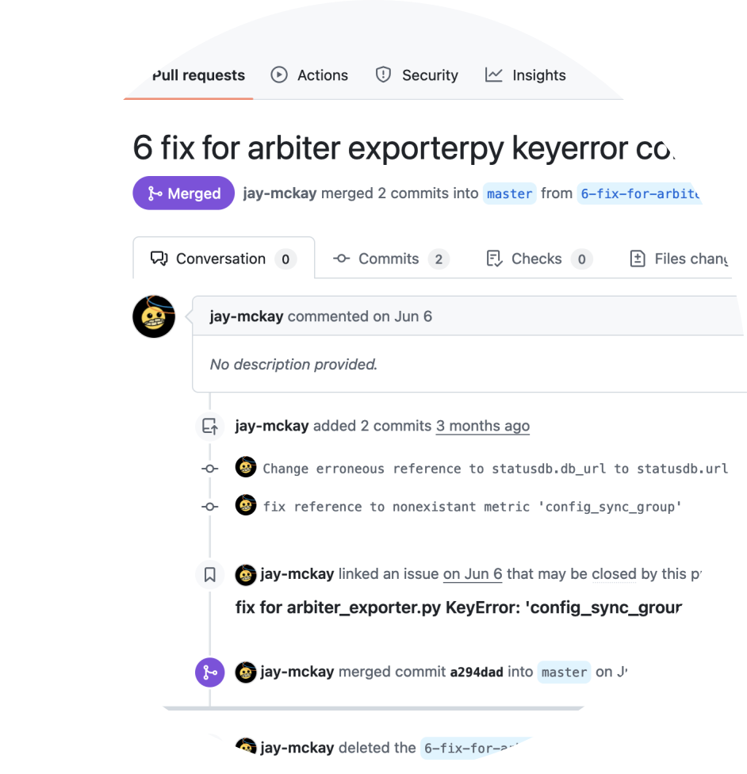
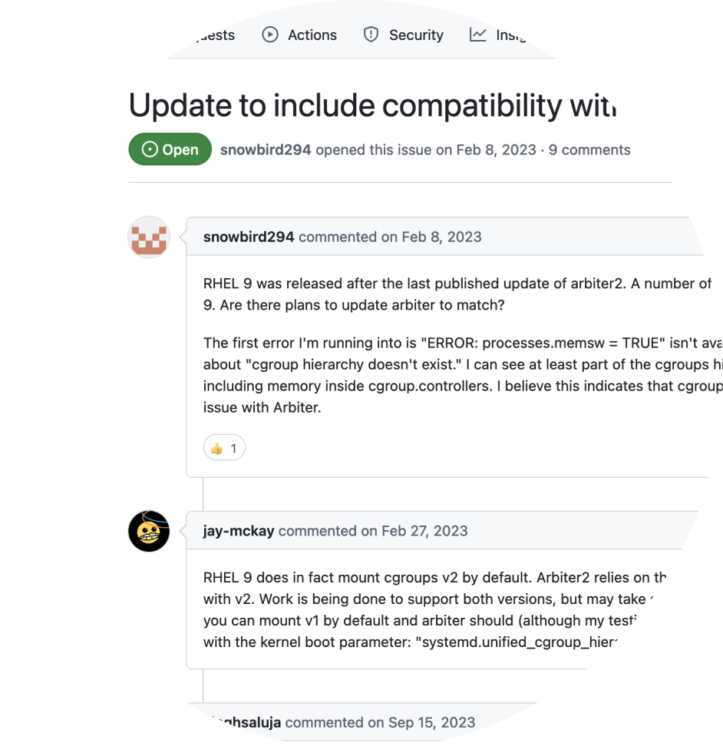
Terminology: Remote repositories

Slide 54
Terminology: Remote repositories
The Center for High Performance Computing has a GitLab instance (gitlab.chpc.utah.edu) that you can use for your projects. It uses your University of Utah credentials. You need to be on the university’s network to use it, so you will need to use the university’s VPN from anywhere off-campus.

Slide 55
End of main course content
You now know enough about Git to use it for your projects!
We’ll continue with a few more topics, but we will likely not have time for hands-on exercises. Please refer to the handout for examples of commands.

Slide 56
Terminology: Stash
You can stash changes (your working tree and index) in the stash. This is useful to clear out changes you don’t need right now but may need at some point. You might use this, for example, when you need a “clean” working tree or index.
You could also make a commit on a new branch, then come back to that branch later if you wanted to incorporate your changes into a different branch.
Examples of using git stash are provided in the handout.

Slide 57

Terminology: Submodules
A submodule is another Git repository that you include as part of your repository. This is the preferred way to refer to other projects, as it allows you to reference specific commits in another project (without including the contents of the other repository in your own).
Image credit: Pierre Bamin on Unsplash
Unsplash License

Slide 58
Terminology: Large File Storage (LFS)
Git LFS is an extension used for versioning large files. It uses “text pointers inside Git,” while the actual files are stored elsewhere. It’s used to keep repositories (relatively) small.
One reason to do this is so that users don’t need to download every past version of large files when they clone your project. (If you have a 20 GB file with 5 revisions, that’d be100 GB to download—and most of your users probably wouldn’t care about the 80 GB of old content that has since been updated.)
Note that hosts like GitHub will reject larger files (as of Fall 2024, GitHub “blocks files larger than 100 MB” and warns about files larger than 50 MB.)

Slide 59

Terminology: Tags
Tags allow you to give a name to a commit. They are commonly used to annotate specific commits with version numbers (e.g., “v1.2”).
Image credit: Kelsy Gagnebin on Unsplash
Unsplash License
Notes:
Note: There are two different kinds of tags; the difference is whether the tag includes metadata

Slide 60
Useful files
There are a few different files that are commonly added to repositories by developers and researchers.

Slide 61
.gitignore
A .gitignore file allows you to designate files as “intentionally untracked.”
This is useful when you don’t want files to end up in your repository, and it allows you to continue using flags like --all without worrying about things like intermediate files (e.g., *.log and *.aux with TeX documents, object files and binaries, user-specific configurations that others would not be interested in).
You can also use a different file by configuring core.excludesFile.

Slide 62
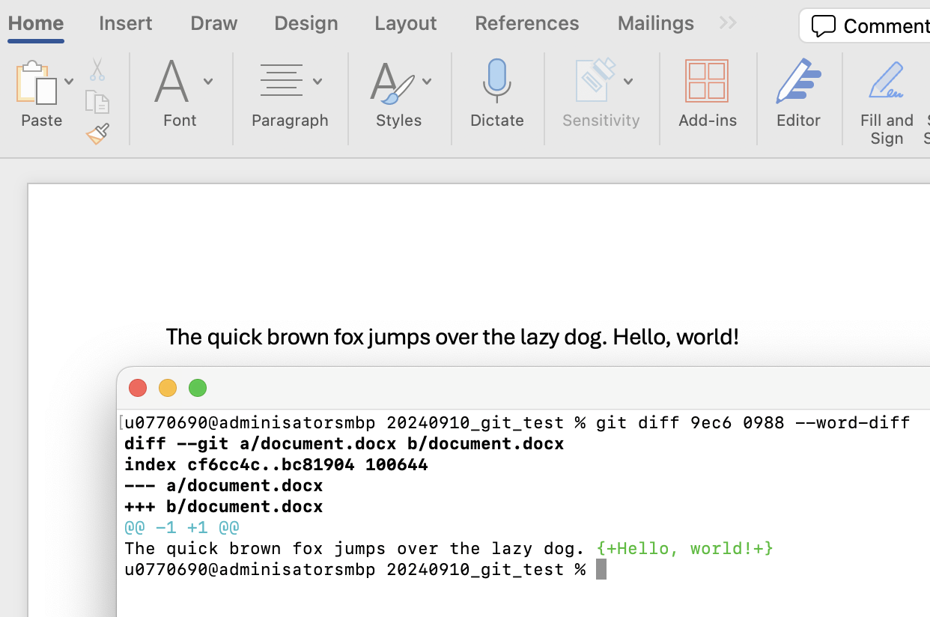
.gitattributes
A .gitattributes file allows you to specify the attributes of specific files. This lets you, for example, identify certain files as binary files and change diff behavior.
In .git/config:
[diff "pandoc"]
textconv = pandoc --to=markdown
In .gitattributes:
*.docx binary diff=pandoc

Slide 63
README
A README file tells potential users and contributors about your project. The README is often written in Markdown, which allows you to add headings, links, tables, images, and other features. This is what’s displayed on project pages on GitHub and similar sites.
We recommend including a README in every project!

Slide 64
LICENSE
A LICENSE file tells users the conditions under which they can use, redistribute, and even commercialize your project contents. Potential users or contributors may avoid your project if the license is unclear.
We recommend including a LICENSE in every project!

Slide 65
Conclusion of presentation
We’ve only just scratched the surface of Git today. There are many other, more advanced topics that we don’t have time to cover in detail.
The material we’ve covered today may be sufficient for your workflow, though, and you should now be able to understand the more advanced topics as you encounter them. We’ve made a lot of progress!

Slide 66

Questions and answers
Do you have any questions?
If we don’t have time to answer your question, or if you think of any questions after the presentation, please reach out to us! helpdesk@chpc.utah.edu

