Slide 1
Introduction to Slurm & Slurm Batch Scripts
Ashley Dederich
Research Consulting & Faculty Engagement
Center for High Performance Computing
ashley.dederich@utah.edu

Slide 2
Overview of Talk
Overview
Basics of a Slurm Script
Getting Started
Example Dataset
Hands On: Batch Scripting
#1: Submitting to Notchpeak Cluster
#2: Submitting to Owner Nodes
Hands On #3: Start an Interactive Job
Hands On #4: Open OnDemand’s Job Composer

Slide 3
Overview of Talk
Overview
Basics of a Slurm Script
Getting Started
Example Dataset
Hands On: Batch Scripting
#1: Submitting to Notchpeak Cluster
#2: Submitting to Owner Nodes
Hands On #3: Start an Interactive Job
Hands On #4: Open OnDemand’s Job Composer

Slide 4
Re-cap of Resources
CHPC resources:
HPC clusters:
General Environment: Granite, Notchpeak, Kingspeak, Lonepeak
Protected Environment (PE): Redwood
Others
VM (Windows, Linux)
Storage
Other Services
Condominium mode:
HPC Cluster = CHPC-owned nodes (general nodes) + PI-owned nodes (owner nodes)
All CHPC users have access to CHPC-owned resources for free. Some clusters (notchpeak) need allocations (peer-reviewed proposals)
Owners (PI group) have the highest priority using owner nodes
All CHPC users have access to owner nodes in Guest mode for free (jobs subject to preemption)

Slide 5

What is Slurm?
Formerly known as Simple Linux Utility for Resource Management
Open-source workload manager for supercomputers/clusters
Manage resources (nodes/cores/memory/interconnect/gpus)
Schedule jobs (queueing/prioritization)
Used by 60% of the TOP500 supercomputers¹
Fun fact: development team based in Lehi, UT
[1] https://en.wikipedia.org/wiki/Slurm_Workload_Manager (2023 Jun)

Slide 6
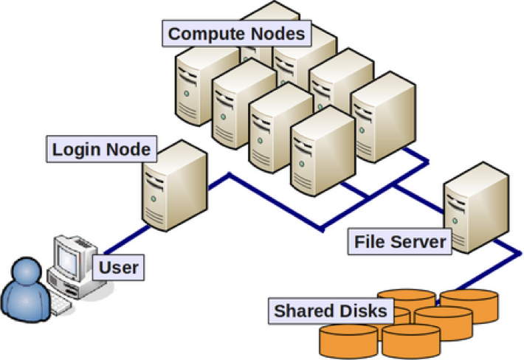
What is Slurm …and why use it?
Goal: you, the user, want to connect to the CHPC machines and analyze some data using R
You don’t want to analyze your data on the login node…
So, you connect to one of our clusters

Slide 7
What is Slurm …and why use it?
The login node has limited resources
You could guess that, in this example, just a few people could overload the login node
Nobody could login, edit files, etc…

Slide 8
What is Slurm …and why use it?
*Slurm allows users to request a compute job to run on compute nodes
Notes:
So, how do we go about asking SLURM to submit a job for us?

Slide 9
What is Slurm …and why use it?
So, how do we ask Slurm to submit a job?
We need to ask for the correct resources
But first, we need to know what those resources are…

Slide 10
Overview of Talk
Overview
Basics of a Slurm Script
Getting Started
Example Dataset
Hands On: Batch Scripting
#1: Submitting to Notchpeak Cluster
#2: Submitting to Owner Nodes
Hands On #3: Start an Interactive Job
Hands On #4: Open OnDemand’s Job Composer

Slide 11
Two Main Slurm Modes
Batch Mode
Non-Interactive (hands-off)
Great for complete workflows

Slide 12
Two Main Slurm Modes
Batch Mode
Non-Interactive (hands-off)
Great for complete workflows
Interactive Mode
Complete work on a compute node interactively
Great for debugging, immediate feedback of commands

Slide 13
Two Main Slurm Modes
Batch Mode
Non-Interactive (hands-off)
Great for complete workflows
Interactive Mode
Complete work on a compute node interactively
Great for debugging, immediate feedback of commands

Slide 14
Example Slurm Script – sh, tcsh
#!/bin/bash
#SBATCH --account=owner-guest
#SBATCH --partition=kingspeak-guest
#SBATCH --qos=kingspeak-guest
#SBATCH --time=02:00:00
#SBATCH --nodes=1
#SBATCH --ntasks=8
#SBATCH --mem=32G
#SBATCH -o slurmjob-%j.out-%N
#SBATCH -e slurmjob-%j.err-%N
#set up the temporary directory
SCRDIR=/scratch/general/vast/$USER/$SLURM_JOB_ID
mkdir -p $SCRDIR
#copy over input files
cp file.input $SCRDIR/
cd $SCRDIR
#Set up whatever package we need to run with
module load <some-module>
#Run the program with our input
myprogram < file.input > file.output
#Move files out of working directory and clean up
cp file.output $HOME/.
cd $HOME
rm -rf $SCRDIR
#!/bin/tcsh
#SBATCH --account=owner-guest
#SBATCH --partition=kingspeak-guest
#SBATCH --qos=kingspeak-guest
#SBATCH --time=02:00:00
#SBATCH --nodes=1
#SBATCH --ntasks=8
#SBATCH --mem=32G
#SBATCH -o slurmjob-%j.out-%N
#SBATCH -e slurmjob-%j.err-%N
#set up the scratch directory
set SCRDIR /scratch/local/$USER/$SLURM_JOB_ID
mkdir -p $SCRDIR
#move input files into scratch directory
cp file.input $SCRDIR/
cd $SCRDIR
#Set up whatever package we need to run with
module load <some-module>
#Run the program with our input
myprogram < file.input > file.output
#Move files out of working directory and clean up
cp file.output $HOME/.
cd $HOME
rm -rf $SCRDIR
Notes:
This is what a slurm script looks like all together. It looks like a lot of information at first, but lets break it down piece by piece.

Slide 15
#!/bin/bash
#SBATCH --account=owner-guest
#SBATCH --partition=kingspeak-guest
#SBATCH --qos=kingspeak-guest
#SBATCH --time=02:00:00
#SBATCH --nodes=1
#SBATCH --ntasks=8
#SBATCH --mem=32G
#SBATCH -o slurmjob-%j.out-%N
#SBATCH -e slurmjob-%j.err-%N
#!/bin/tcsh
#SBATCH --account=owner-guest
#SBATCH --partition=kingspeak-guest
#SBATCH --qos=kingspeak-guest
#SBATCH --time=02:00:00
#SBATCH --nodes=1
#SBATCH --ntasks=8
#SBATCH --mem=32G
#SBATCH -o slurmjob-%j.out-%N
#SBATCH -e slurmjob-%j.err-%N
Notes:
The first thing you will need to fill out are the #SBATCH directives. Lets focus on the most important part – account and partition

Slide 16
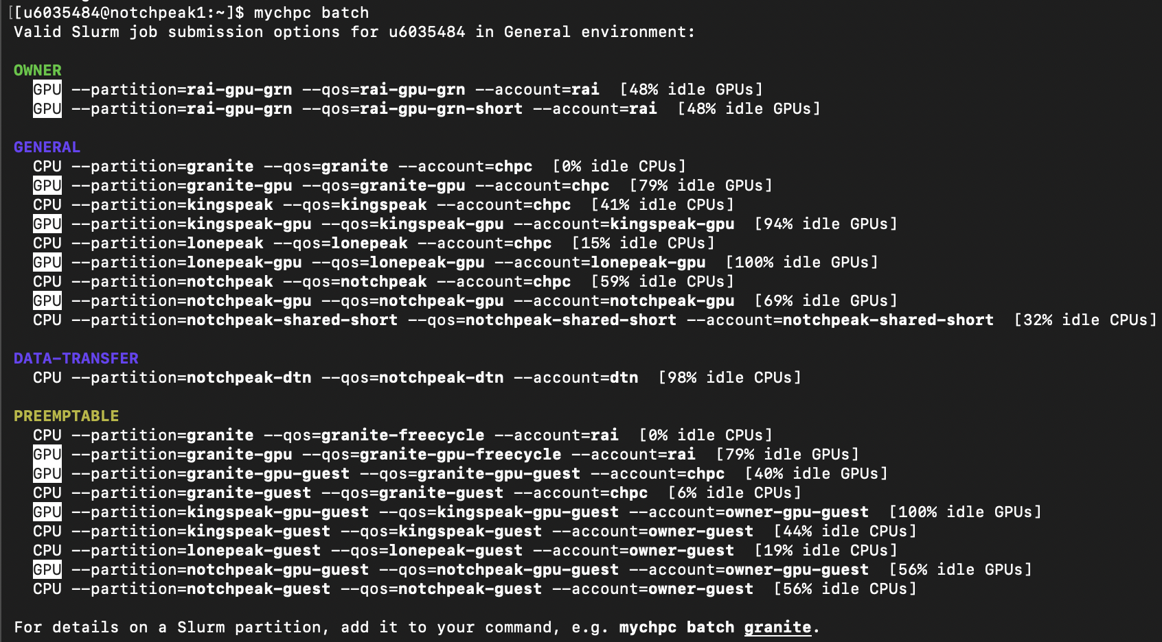
Preparing a Slurm Job
mychpc batch
Helpful command; shows what resources you have access to
Allocation state
partition
qos
account
Notes:
Cluster, account, and partition are information you will need to submit a SLURM job.

Slide 17
#!/bin/bash
#SBATCH --account=owner-guest
#SBATCH --partition=kingspeak-guest
#SBATCH --qos=kingspeak-guest
#SBATCH --time=02:00:00
#SBATCH --nodes=1
#SBATCH --ntasks=8
#SBATCH --mem=32G
#SBATCH -o slurmjob-%j.out-%N
#SBATCH -e slurmjob-%j.err-%N
#!/bin/tcsh
#SBATCH --account=owner-guest
#SBATCH --partition=kingspeak-guest
#SBATCH --qos=kingspeak-guest
#SBATCH --time=02:00:00
#SBATCH --nodes=1
#SBATCH --ntasks=8
#SBATCH --mem=32G
#SBATCH -o slurmjob-%j.out-%N
#SBATCH -e slurmjob-%j.err-%N
#SBATCH --time=02:00:00 specifies wall time of a job in Hours:Minutes:Seconds
#SBATCH -t 02:00:00
also works

Slide 18
Example Slurm Script – sh, tcsh
#!/bin/bash
#SBATCH --account=owner-guest
#SBATCH --partition=kingspeak-guest
#SBATCH --qos=kingspeak-guest
#SBATCH --time=02:00:00
#SBATCH --nodes=1
#SBATCH --ntasks=8
#SBATCH --mem=32G
#SBATCH -o slurmjob-%j.out-%N
#SBATCH -e slurmjob-%j.err-%N
#!/bin/tcsh
#SBATCH --account=owner-guest
#SBATCH --partition=kingspeak-guest
#SBATCH --qos=kingspeak-guest
#SBATCH --time=02:00:00
#SBATCH --nodes=1
#SBATCH --ntasks=8
#SBATCH --mem=32G
#SBATCH -o slurmjob-%j.out-%N
#SBATCH -e slurmjob-%j.err-%N
#SBATCH --nodes=1 specifies number of nodes
#SBATCH -N 1
also works

Slide 19
#!/bin/bash
#SBATCH --account=owner-guest
#SBATCH --partition=kingspeak-guest
#SBATCH --qos=kingspeak-guest
#SBATCH --time=02:00:00
#SBATCH --nodes=1
#SBATCH --ntasks=8
#SBATCH --mem=32G
#SBATCH -o slurmjob-%j.out-%N
#SBATCH -e slurmjob-%j.err-%N
#!/bin/tcsh
#SBATCH --account=owner-guest
#SBATCH --partition=kingspeak-guest
#SBATCH --qos=kingspeak-guest
#SBATCH --time=02:00:00
#SBATCH --nodes=1
#SBATCH --ntasks=8
#SBATCH --mem=32G
#SBATCH -o slurmjob-%j.out-%N
#SBATCH -e slurmjob-%j.err-%N
#SBATCH --ntasks=8 total number of CPUs per node
#SBATCH -n 8
also works

Slide 20
Example Slurm Script – sh, tcsh
#!/bin/bash
#SBATCH --account=owner-guest
#SBATCH --partition=kingspeak-guest
#SBATCH --qos=kingspeak-guest
#SBATCH --time=02:00:00
#SBATCH --nodes=1
#SBATCH --ntasks=8
#SBATCH --mem=32G
#SBATCH -o slurmjob-%j.out-%N
#SBATCH -e slurmjob-%j.err-%N
#!/bin/tcsh
#SBATCH --account=owner-guest
#SBATCH --partition=kingspeak-guest
#SBATCH --qos=kingspeak-guest
#SBATCH --time=02:00:00
#SBATCH --nodes=1
#SBATCH --ntasks=8
#SBATCH --mem=32G
#SBATCH -o slurmjob-%j.out-%N
#SBATCH -e slurmjob-%j.err-%N
#SBATCH --mem=32GB specifies total memory per node
#SBATCH --mem=0 gives you memory of whole node

Slide 21
#!/bin/bash
#SBATCH --account=owner-guest
#SBATCH --partition=kingspeak-guest
#SBATCH --qos=kingspeak-guest
#SBATCH --time=02:00:00
#SBATCH --nodes=1
#SBATCH --ntasks=8
#SBATCH --mem=32G
#SBATCH -o slurmjob-%j.out-%N
#SBATCH -e slurmjob-%j.err-%N
#!/bin/tcsh
#SBATCH --account=owner-guest
#SBATCH --partition=kingspeak-guest
#SBATCH --qos=kingspeak-guest
#SBATCH --time=02:00:00
#SBATCH --nodes=1
#SBATCH --ntasks=8
#SBATCH --mem=32G
#SBATCH -o slurmjob-%j.out-%N
#SBATCH -e slurmjob-%j.err-%N
#SBATCH -o outputs standard output in the form slurmjob-<JOBID>.out-<NODEID>
#SBATCH -e outputs error messages in the form slurmjob-<JOBID>.err-<NODEID>

Slide 22
Example Slurm Script – sh, tcsh
#!/bin/bash
#SBATCH --account=owner-guest
#SBATCH --partition=kingspeak-guest
#SBATCH --qos=kingspeak-guest
#SBATCH --time=02:00:00
#SBATCH --nodes=1
#SBATCH --ntasks=8
#SBATCH --mem=32G
#SBATCH -o slurmjob-%j.out-%N
#SBATCH -e slurmjob-%j.err-%N
#SBATCH --constraint <CONSTRAINTS>
#!/bin/tcsh
#SBATCH --account=owner-guest
#SBATCH --partition=kingspeak-guest
#SBATCH --qos=kingspeak-guest
#SBATCH --time=02:00:00
#SBATCH --nodes=1
#SBATCH --ntasks=8
#SBATCH --mem=32G
#SBATCH -o slurmjob-%j.out-%N
#SBATCH -e slurmjob-%j.err-%N
#SBATCH --constraint <CONSTRAINTS>
Can also include constraints to target specific nodes
This can be memory avail, cpu count, specific owner nodes, etc

Slide 23
#!/bin/bash
#SBATCH --account=owner-guest
#SBATCH --partition=kingspeak-guest
#SBATCH --qos=kingspeak-guest
#SBATCH --time=02:00:00
#SBATCH --nodes=1
#SBATCH --ntasks=8
#SBATCH --mem=32G
#SBATCH -o slurmjob-%j.out-%N
#SBATCH -e slurmjob-%j.err-%N
#SBATCH --constraint “c40”
#!/bin/tcsh
#SBATCH --account=owner-guest
#SBATCH --partition=kingspeak-guest
#SBATCH --qos=kingspeak-guest
#SBATCH --time=02:00:00
#SBATCH --nodes=1
#SBATCH --ntasks=8
#SBATCH --mem=32G
#SBATCH -o slurmjob-%j.out-%N
#SBATCH -e slurmjob-%j.err-%N
#SBATCH --constraint “m768”
Can also include constraints to target specific nodes
This can be memory avail, cpu count, specific owner nodes, etc

Slide 24
Example Slurm Script – sh, tcsh
#!/bin/bash
#SBATCH --account=owner-guest
#SBATCH --partition=kingspeak-guest
#SBATCH --qos=kingspeak-guest
#SBATCH --time=02:00:00
#SBATCH --nodes=1
#SBATCH --ntasks=8
#SBATCH --mem=32G
#SBATCH -o slurmjob-%j.out-%N
#SBATCH -e slurmjob-%j.err-%N
#SBATCH --constraint “c40&m768”
#!/bin/tcsh
#SBATCH --account=owner-guest
#SBATCH --partition=kingspeak-guest
#SBATCH --qos=kingspeak-guest
#SBATCH --time=02:00:00
#SBATCH --nodes=1
#SBATCH --ntasks=8
#SBATCH --mem=32G
#SBATCH -o slurmjob-%j.out-%N
#SBATCH -e slurmjob-%j.err-%N
#SBATCH --constraint “c40|c36”
Include c40 AND m768 nodes
Include c40 OR c36 nodes
Can also include constraints to target specific nodes
This can be memory avail, cpu count, specific owner nodes, etc

Slide 25
#!/bin/bash
#SBATCH --account=owner-guest
#SBATCH --partition=kingspeak-guest
#SBATCH --qos=kingspeak-guest
#SBATCH --time=02:00:00
#SBATCH --nodes=1
#SBATCH --ntasks=8
#SBATCH --mem=32G
#SBATCH -o slurmjob-%j.out-%N
#SBATCH -e slurmjob-%j.err-%N
#SBATCH --constraint “gompert”
#!/bin/tcsh
#SBATCH --account=owner-guest
#SBATCH --partition=kingspeak-guest
#SBATCH --qos=kingspeak-guest
#SBATCH --time=02:00:00
#SBATCH --nodes=1
#SBATCH --ntasks=8
#SBATCH --mem=32G
#SBATCH -o slurmjob-%j.out-%N
#SBATCH -e slurmjob-%j.err-%N
#SBATCH --constraint “gompert|schmidt|tbicc”
Can also include constraints to target specific nodes
This can be memory avail, cpu count, specific owner nodes, etc
https://www.chpc.utah.edu/usage/constraints/
Notes:
But, for now, we don’t want to worry about constraints

Slide 26
Example Slurm Script – sh, tcsh
#!/bin/bash
#SBATCH --account=owner-guest
#SBATCH --partition=kingspeak-guest
#SBATCH --qos=kingspeak-guest
#SBATCH --time=02:00:00
#SBATCH --nodes=1
#SBATCH --ntasks=8
#SBATCH --mem=32G
#SBATCH -o slurmjob-%j.out-%N
#SBATCH -e slurmjob-%j.err-%N
#SBATCH --mail-type=FAIL,BEGIN,END
#SBATCH --mail-user=ashley.dederich@utah.edu
#!/bin/tcsh
#SBATCH --account=owner-guest
#SBATCH --partition=kingspeak-guest
#SBATCH --qos=kingspeak-guest
#SBATCH --time=02:00:00
#SBATCH --nodes=1
#SBATCH --ntasks=8
#SBATCH --mem=32G
#SBATCH -o slurmjob-%j.out-%N
#SBATCH -e slurmjob-%j.err-%N
#SBATCH --mail-type=FAIL,BEGIN,END
#SBATCH --mail-user=ashley.dederich@utah.edu
Can also have Slurm email you with updates
Useful to monitor the status of jobs without constantly checking via squeue
Notes:
But, for now, we don’t want to worry about constraints
#SBATCH --mail-type=FAIL,BEGIN,END
#SBATCH --mail-user=ashley.dederich@usu.edu

Slide 27
#!/bin/bash
#SBATCH --account=owner-guest
#SBATCH --partition=kingspeak-guest
#SBATCH --qos=kingspeak-guest
#SBATCH --time=02:00:00
#SBATCH --nodes=1
#SBATCH --ntasks=8
#SBATCH --mem=32G
#SBATCH -o slurmjob-%j.out-%N
#SBATCH -e slurmjob-%j.err-%N
#set up the temporary directory
SCRDIR=/scratch/general/vast/$USER/$SLURM_JOB_ID
mkdir -p $SCRDIR
#copy over input files
cp file.input $SCRDIR/.
cd $SCRDIR
#!/bin/tcsh
#SBATCH --account=owner-guest
#SBATCH --partition=kingspeak-guest
#SBATCH --qos=kingspeak-guest
#SBATCH --time=02:00:00
#SBATCH --nodes=1
#SBATCH --ntasks=8
#SBATCH --mem=32G
#SBATCH -o slurmjob-%j.out-%N
#SBATCH -e slurmjob-%j.err-%N
#set up the scratch directory
set SCRDIR /scratch/local/$USER/$SLURM_JOB_ID
mkdir -p $SCRDIR
#move input files into scratch directory
cp file.input $SCRDIR/.
cd $SCRDIR
Now, we will discuss the best way to stage your files for analysis
Notes:
This is what a slurm script looks like all together. It looks like a lot of information at first, but lets break it down piece by piece.

Slide 28
CHPC Storage Resources
Home
Scratch
Group
Free
Automatically provisioned
50GB soft limit
Free
For intermediate files required during a job
vast – 50TB/user quota
nfs1 – no quota
Needs to be purchased by PI
By the TB
Notes:
We have three main storage systems here
We recommend using scratch when running your job
Here is how you can go about doing that

Slide 29
Example Slurm Script – sh, tcsh
#!/bin/bash
#SBATCH --account=owner-guest
#SBATCH --partition=kingspeak-guest
#SBATCH --qos=kingspeak-guest
#SBATCH --time=02:00:00
#SBATCH --nodes=1
#SBATCH --ntasks=8
#SBATCH --mem=32G
#SBATCH -o slurmjob-%j.out-%N
#SBATCH -e slurmjob-%j.err-%N
#set up the temporary directory
SCRDIR=/scratch/general/vast/$USER/$SLURM_JOB_ID
mkdir -p $SCRDIR
#copy over input files
cp file.input $SCRDIR/.
cd $SCRDIR
#!/bin/tcsh
#SBATCH --account=owner-guest
#SBATCH --partition=kingspeak-guest
#SBATCH --qos=kingspeak-guest
#SBATCH --time=02:00:00
#SBATCH --nodes=1
#SBATCH --ntasks=8
#SBATCH --mem=32G
#SBATCH -o slurmjob-%j.out-%N
#SBATCH -e slurmjob-%j.err-%N
#set up the scratch directory
set SCRDIR /scratch/local/$USER/$SLURM_JOB_ID
mkdir -p $SCRDIR
#move input files into scratch directory
cp file.input $SCRDIR/.
cd $SCRDIR
Points to your uNID
Points to your uNID
Create an environmental variable that points to scratch path
Notes:
Create environmental var
$USER
Notice $SLURM_JOB_ID – lets talk about this

Slide 30
Example Slurm Script – sh, tcsh
#!/bin/bash
#SBATCH --account=owner-guest
#SBATCH --partition=kingspeak-guest
#SBATCH --qos=kingspeak-guest
#SBATCH --time=02:00:00
#SBATCH --nodes=1
#SBATCH --ntasks=8
#SBATCH --mem=32G
#SBATCH -o slurmjob-%j.out-%N
#SBATCH -e slurmjob-%j.err-%N
#set up the temporary directory
SCRDIR=/scratch/general/vast/$USER/$SLURM_JOB_ID
mkdir -p $SCRDIR
#copy over input files
cp file.input $SCRDIR/.
cd $SCRDIR
#!/bin/tcsh
#SBATCH --account=owner-guest
#SBATCH --partition=kingspeak-guest
#SBATCH --qos=kingspeak-guest
#SBATCH --time=02:00:00
#SBATCH --nodes=1
#SBATCH --ntasks=8
#SBATCH --mem=32G
#SBATCH -o slurmjob-%j.out-%N
#SBATCH -e slurmjob-%j.err-%N
#set up the scratch directory
set SCRDIR /scratch/local/$USER/$SLURM_JOB_ID
mkdir -p $SCRDIR
#move input files into scratch directory
cp file.input $SCRDIR/.
cd $SCRDIR
Create the working directory
Notes:
Create environmental var
$USER
Notice $SLURM_JOB_ID – lets talk about this

Slide 31
Slurm Environment Variables
Some useful environment variables:
$SLURM_JOB_ID
$SLURM_SUBMIT_DIR
$SLURM_NNODES
$SLURM_NTASKS
Can get them for a given set of directives by using the env command inside a script (or in a srun session).
See: https://slurm.schedmd.com/sbatch.html#SECTION_OUTPUT-ENVIRONMENT-VARIABLES
Notes:
SLURM sets environmental variables for us that we can call in our script, including $SLURM_JOB_ID
There is a whole bunch of different vars that slurm sets, you can see a complete list at this link, available in the pdf of these slides.
Back to our regularly scheduled programming

Slide 32
Example Slurm Script – sh, tcsh
#!/bin/bash
#SBATCH --account=owner-guest
#SBATCH --partition=kingspeak-guest
#SBATCH --qos=kingspeak-guest
#SBATCH --time=02:00:00
#SBATCH --nodes=1
#SBATCH --ntasks=8
#SBATCH --mem=32G
#SBATCH -o slurmjob-%j.out-%N
#SBATCH -e slurmjob-%j.err-%N
#set up the temporary directory
SCRDIR=/scratch/general/vast/$USER/$SLURM_JOB_ID
mkdir -p $SCRDIR
#copy over input files
cp file.input $SCRDIR/.
cd $SCRDIR
#!/bin/tcsh
#SBATCH --account=owner-guest
#SBATCH --partition=kingspeak-guest
#SBATCH --qos=kingspeak-guest
#SBATCH --time=02:00:00
#SBATCH --nodes=1
#SBATCH --ntasks=8
#SBATCH --mem=32G
#SBATCH -o slurmjob-%j.out-%N
#SBATCH -e slurmjob-%j.err-%N
#set up the scratch directory
set SCRDIR /scratch/local/$USER/$SLURM_JOB_ID
mkdir -p $SCRDIR
#move input files into scratch directory
cp file.input $SCRDIR/.
cd $SCRDIR
Create the scratch directory
Notes:
Create environmental var
$USER
Notice $SLURM_JOB_ID – lets talk about this

Slide 33
#!/bin/bash
#SBATCH --account=owner-guest
#SBATCH --partition=kingspeak-guest
#SBATCH --qos=kingspeak-guest
#SBATCH --time=02:00:00
#SBATCH --nodes=1
#SBATCH --ntasks=8
#SBATCH --mem=32G
#SBATCH -o slurmjob-%j.out-%N
#SBATCH -e slurmjob-%j.err-%N
#set up the temporary directory
SCRDIR=/scratch/general/vast/$USER/$SLURM_JOB_ID
mkdir -p $SCRDIR
#copy over input files
cp file.input $SCRDIR/.
cd $SCRDIR
#!/bin/tcsh
#SBATCH --account=owner-guest
#SBATCH --partition=kingspeak-guest
#SBATCH --qos=kingspeak-guest
#SBATCH --time=02:00:00
#SBATCH --nodes=1
#SBATCH --ntasks=8
#SBATCH --mem=32G
#SBATCH -o slurmjob-%j.out-%N
#SBATCH -e slurmjob-%j.err-%N
#set up the scratch directory
set SCRDIR /scratch/local/$USER/$SLURM_JOB_ID
mkdir -p $SCRDIR
#move input files into scratch directory
cp file.input $SCRDIR/.
cd $SCRDIR
Copy over input files and move on over to $SCRDIR

Slide 34
Example Slurm Script – sh, tcsh
#!/bin/bash
#SBATCH --account=owner-guest
#SBATCH --partition=kingspeak-guest
#SBATCH --qos=kingspeak-guest
#SBATCH --time=02:00:00
#SBATCH --nodes=1
#SBATCH --ntasks=8
#SBATCH --mem=32G
#SBATCH -o slurmjob-%j.out-%N
#SBATCH -e slurmjob-%j.err-%N
#set up the temporary directory
SCRDIR=/scratch/general/vast/$USER/$SLURM_JOB_ID
mkdir -p $SCRDIR
#copy over input files
cp file.input $SCRDIR/.
cd $SCRDIR
#Set up whatever package we need to run with
module load <some-module>
#!/bin/tcsh
#SBATCH --account=owner-guest
#SBATCH --partition=kingspeak-guest
#SBATCH --qos=kingspeak-guest
#SBATCH --time=02:00:00
#SBATCH --nodes=1
#SBATCH --ntasks=8
#SBATCH --mem=32G
#SBATCH -o slurmjob-%j.out-%N
#SBATCH -e slurmjob-%j.err-%N
#set up the scratch directory
set SCRDIR /scratch/local/$USER/$SLURM_JOB_ID
mkdir -p $SCRDIR
#move input files into scratch directory
cp file.input $SCRDIR/.
cd $SCRDIR
#Set up whatever package we need to run with
module load <some-module>
Load the desired modules
Notes:
Load the desired modules into your environment so that the computer can recognize the commands you are giving it

Slide 35
#!/bin/bash
#SBATCH --account=owner-guest
#SBATCH --partition=kingspeak-guest
#SBATCH --qos=kingspeak-guest
#SBATCH --time=02:00:00
#SBATCH --nodes=1
#SBATCH --ntasks=8
#SBATCH --mem=32G
#SBATCH -o slurmjob-%j.out-%N
#SBATCH -e slurmjob-%j.err-%N
#set up the temporary directory
SCRDIR=/scratch/general/vast/$USER/$SLURM_JOB_ID
mkdir -p $SCRDIR
#copy over input files
cp file.input $SCRDIR/.
cd $SCRDIR
#Set up whatever package we need to run with
module load <some-module>
#Run the program with our input
myprogram < file.input > file.output
#!/bin/tcsh
#SBATCH --account=owner-guest
#SBATCH --partition=kingspeak-guest
#SBATCH --qos=kingspeak-guest
#SBATCH --time=02:00:00
#SBATCH --nodes=1
#SBATCH --ntasks=8
#SBATCH --mem=32G
#SBATCH -o slurmjob-%j.out-%N
#SBATCH -e slurmjob-%j.err-%N
#set up the scratch directory
set SCRDIR /scratch/local/$USER/$SLURM_JOB_ID
mkdir -p $SCRDIR
#move input files into scratch directory
cp file.input $SCRDIR/.
cd $SCRDIR
#Set up whatever package we need to run with
module load <some-module>
#Run the program with our input
myprogram < file.input > file.output
Run the program you need to
Notes:
This is what a slurm script looks like all together. It looks like a lot of information at first, but lets break it down piece by piece.

Slide 36
Slurm File Structure (in sh and tcsh)
#!/bin/bash
#SBATCH --account=owner-guest
#SBATCH --partition=kingspeak-guest
#SBATCH --qos=kingspeak-guest
#SBATCH --time=02:00:00
#SBATCH --nodes=1
#SBATCH --ntasks=8
#SBATCH --mem=32G
#SBATCH -o slurmjob-%j.out-%N
#SBATCH -e slurmjob-%j.err-%N
#set up the temporary directory
SCRDIR=/scratch/general/vast/$USER/$SLURM_JOB_ID
mkdir -p $SCRDIR
#copy over input files
cp file.input $SCRDIR/.
cd $SCRDIR
#Set up whatever package we need to run with
module load <some-module>
#Run the program with our input
myprogram < file.input > file.output
#Move files out of working directory and clean up
cp file.output $HOME/.
cd $HOME
rm -rf $SCRDIR
#!/bin/tcsh
#SBATCH --account=owner-guest
#SBATCH --partition=kingspeak-guest
#SBATCH --qos=kingspeak-guest
#SBATCH --time=02:00:00
#SBATCH --nodes=1
#SBATCH --ntasks=8
#SBATCH --mem=32G
#SBATCH -o slurmjob-%j.out-%N
#SBATCH -e slurmjob-%j.err-%N
#set up the scratch directory
set SCRDIR /scratch/local/$USER/$SLURM_JOB_ID
mkdir -p $SCRDIR
#move input files into scratch directory
cp file.input $SCRDIR/.
cd $SCRDIR
#Set up whatever package we need to run with
module load <some-module>
#Run the program with our input
myprogram < file.input > file.output
#Move files out of working directory and clean up
cp file.output $HOME/.
cd $HOME
rm -rf $SCRDIR
Copy output to your $HOME
Copy output to your $HOME
Move back to $HOME
Move back to $HOME
Remove $SCRDIR
Remove $SCRDIR
Notes:
Finally, you clean up after yourself.
Removing $SCRDIR is the most important part, because the scratch directories (vast and nfs1) frequently fill up and we have to remind users to clean up those directories.

Slide 37
Example Slurm Script – sh, tcsh
#!/bin/bash
#SBATCH --account=owner-guest
#SBATCH --partition=kingspeak-guest
#SBATCH --qos=kingspeak-guest
#SBATCH --time=02:00:00
#SBATCH --nodes=1
#SBATCH --ntasks=8
#SBATCH --mem=32G
#SBATCH -o slurmjob-%j.out-%N
#SBATCH -e slurmjob-%j.err-%N
#set up the temporary directory
SCRDIR=/scratch/general/vast/$USER/$SLURM_JOB_ID
mkdir -p $SCRDIR
#copy over input files
cp file.input $SCRDIR/.
cd $SCRDIR
#Set up whatever package we need to run with
module load <some-module>
#Run the program with our input
myprogram < file.input > file.output
#Move files out of working directory and clean up
cp file.output $HOME/.
cd $HOME
rm -rf $SCRDIR
#!/bin/tcsh
#SBATCH --account=owner-guest
#SBATCH --partition=kingspeak-guest
#SBATCH --qos=kingspeak-guest
#SBATCH --time=02:00:00
#SBATCH --nodes=1
#SBATCH --ntasks=8
#SBATCH --mem=32G
#SBATCH -o slurmjob-%j.out-%N
#SBATCH -e slurmjob-%j.err-%N
#set up the scratch directory
set SCRDIR /scratch/local/$USER/$SLURM_JOB_ID
mkdir -p $SCRDIR
#move input files into scratch directory
cp file.input $SCRDIR/.
cd $SCRDIR
#Set up whatever package we need to run with
module load <some-module>
#Run the program with our input
myprogram < file.input > file.output
#Move files out of working directory and clean up
cp file.output $HOME/.
cd $HOME
rm -rf $SCRDIR
Done! Let’s call this file
FirstSlurmScript.sbatch
Notes:
And there you have it! You have a whole SLURM script.

Slide 38
Basic Slurm commands
sbatch FirstSlurmScript.sbatch - launch a batch job
Job ID
Notes:
sbatch is the command to use. If your #SBATCH directives have no errors, you will see a message pop up that looks like this…
This is the SLURM job id

Slide 39
Basic Slurm commands
sbatch FirstSlurmScript.sbatch - launch a batch job
squeue - shows all jobs in queue
squeue --me - shows only your jobs
squeue -u <uNID> - shows only your jobs
mysqueue* - shows job queue per partition and associated accounts you have access to on the cluster
*CHPC developed programs. See CHPC Newsletter 2023 Summer
Notes:
Give demonstration

Slide 40
Basic Slurm commands
sbatch FirstSlurmScript.sbatch - launch a batch job
squeue - shows all jobs in queue
squeue --me - shows only your jobs
squeue -u <uNID> - shows only your jobs
mysqueue* - shows job queue per partition and associated accounts you have access to on the cluster
scancel <jobid> - cancel a job
*CHPC developed programs. See CHPC Newsletter 2023 Summer
scancel 13335248

Slide 41
Basic Slurm commands
sbatch FirstSlurmScript.sbatch - launch a batch job
squeue - shows all jobs in queue
squeue --me - shows only your jobs
squeue -u <uNID> - shows only your jobs
mysqueue* - shows job queue per partition and associated accounts you have access to on the cluster
scancel <jobid> - cancel a job
sinfo - shows all partitions/nodes state
mysinfo* - info on partitions/nodes and associated accounts you have access to on the cluster
*CHPC developed programs. See CHPC Newsletter 2023 Summer
Notes:
Give example of sinfo –help, sinfo –p notchpeak-guest, sinfo -N

Slide 42
Basic Slurm commands
sbatch FirstSlurmScript.sbatch - launch a batch job
squeue - shows all jobs in queue
squeue --me - shows only your jobs
squeue -u <uNID> - shows only your jobs
mysqueue* - shows job queue per partition and associated accounts you have access to on the cluster
scancel <jobid> - cancel a job
sinfo - shows all partitions/nodes state
mysinfo* - info on partitions/nodes and associated accounts you have access to on the cluster
salloc – start an interactive job
Works with same #SBATCH directives
*CHPC developed programs. See CHPC Newsletter 2023 Summer
Notes:
The last thing you can do is request an interactive node through SLURM with the salloc command
Useful if you have a program that you need to interact with through the command line
Works with same #SBATCH directives
Give a demonstration salloc –partition notchpeak-shared-short –account notchpeak-shared-short –N 1 –t 01:00:00

Slide 43
Basic Slurm commands
**note** – all of these commands only work on the cluster you are currently logged into.
To recognize a different cluster, use these flags:
-M all
-M kingspeak
--clusters all
--clusters kingspeak
sbatch FirstSlurmScript.sbatch - launch a batch job
squeue - shows all jobs in queue
squeue --me - shows only your jobs
squeue -u <uNID> - shows only your jobs
mysqueue* - shows job queue per partition and associated accounts you have access to on the cluster
scancel <jobid> - cancel a job
sinfo - shows all partitions/nodes state
mysinfo* - info on partitions/nodes and associated accounts you have access to on the cluster
salloc – start an interactive job
Works with same #SBATCH directives
*CHPC developed programs. See CHPC Newsletter 2023 Summer
Notes:
The last thing you can do is request an interactive node through SLURM with the salloc command
Useful if you have a program that you need to interact with through the command line
Works with same #SBATCH directives
Give a demonstration salloc –partition notchpeak-shared-short –account notchpeak-shared-short –N 1 –t 01:00:00

Slide 44
Overview of Talk
Overview
Basics of a Slurm Script
Getting Started
Example Dataset
Hands On: Batch Scripting
#1: Submitting to Notchpeak Cluster
#2: Submitting to Owner Nodes
Hands On #3: Start an Interactive Job
Hands On #4: Open OnDemand’s Job Composer

Slide 45
Getting Started
Download github repo:
git clone https://github.com/chpc-uofu/slurm-lectures.git

Slide 46
Overview of Talk
Overview
Basics of a Slurm Script
Getting Started
Example Dataset
Hands On: Batch Scripting
#1: Submitting to Notchpeak Cluster
#2: Submitting to Owner Nodes
Hands On #3: Start an Interactive Job
Hands On #4: Open OnDemand’s Job Composer

Slide 47
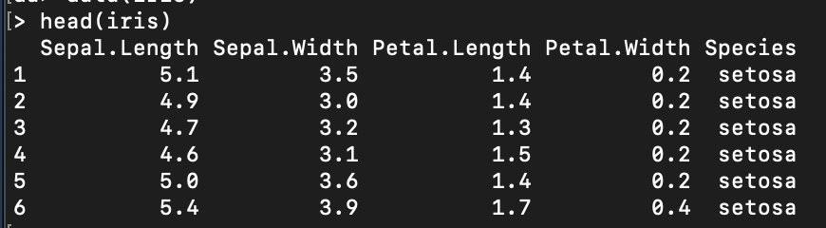
Example Dataset
R has built-in datasets
Using the iris dataset

Slide 48
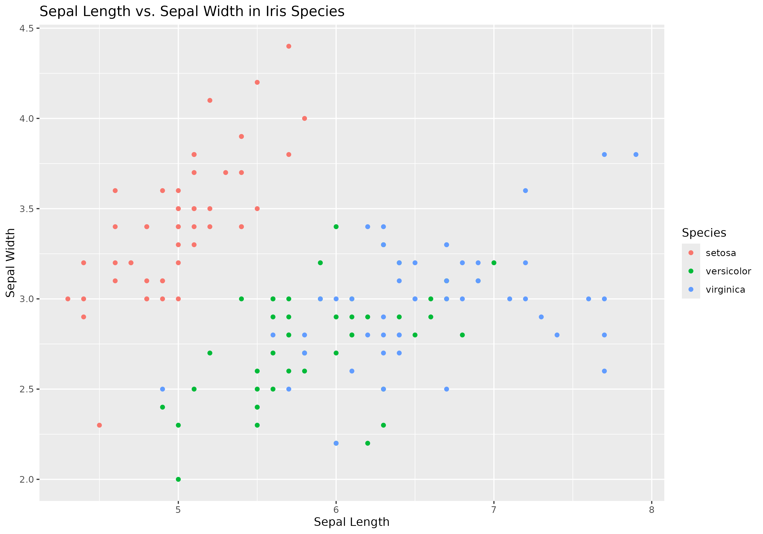
data_visualization.r
Script takes in iris.csv as a parameter
Plots sepal width vs. sepal length
Saves graph as IrisData.png

Slide 49
Overview of Talk
Overview
Basics of a Slurm Script
Getting Started
Example Dataset
Hands On: Batch Scripting
#1: Submitting to Notchpeak Cluster
#2: Submitting to Owner Nodes
Hands On #3: Start an Interactive Job
Hands On #4: Open OnDemand’s Job Composer

Slide 50
Overview of Talk
Overview
Basics of a Slurm Script
Getting Started
Example Dataset
Hands On: Batch Scripting
#1: Submitting to Notchpeak Cluster
#2: Submitting to Owner Nodes
Hands On #3: Start an Interactive Job
Hands On #4: Open OnDemand’s Job Composer

Slide 51
Hands On #1: Batch Scripting
Goal: Write a Slurm script that will copy the input data and R script over to a scratch directory and run the R script, meeting the following requirements:
Submit to Notchpeak’s shared-short partition
Request 1 CPU
Requests 25GB of memory
Runs for 5 minutes
Creates .out and .err files

Slide 52
Overview of Talk
Overview
Basics of a Slurm Script
Getting Started
Example Dataset
Hands On: Batch Scripting
#1: Submitting to Notchpeak Cluster
#2: Submitting to Owner Nodes
Hands On #3: Start an Interactive Job
Hands On #4: Open OnDemand’s Job Composer

Slide 53
Hands On #2: Batch Scripting
Goal: Write a Slurm script that will copy the input data and R script over to a scratch directory and run the R script, meeting the following requirements:
Submit to owner nodes on Notchpeak
Request 1 CPU
Requests 25GB of memory
Runs for 5 minutes
Creates .out and .err files

Slide 54
Hands On #2: Batch Scripting
Goal: Write a Slurm script that will copy the input data and R script over to a scratch directory and run the R script, meeting the following requirements:
Submit to owner nodes on Notchpeak
Request 1 CPU
Requests 25GB of memory
Runs for 5 minutes
Creates .out and .err files

Slide 55
Overview of Talk
Overview
Basics of a Slurm Script
Getting Started
Example Dataset
Hands On: Batch Scripting
#1: Submitting to Notchpeak Cluster
#2: Submitting to Owner Nodes
Hands On #3: Start an Interactive Job
Hands On #4: Open OnDemand’s Job Composer

Slide 56
Running interactive batch jobs
An interactive command is launched through the salloc command

Slide 57
Running interactive batch jobs
An interactive command is launched through the salloc command salloc --time=8:00:00 -–ntasks=4 --nodes=1 –-mem=16G --account=<account> --partition=kingspeak-shared --qos=kingspeak

Slide 58
Hands On #3: Start an Interactive Job
Start an interactive session with salloc command and specify:
Notchpeak-shared-short partition and associated account
10 minutes time
Run the R script
Exit when R script has completed

Slide 59
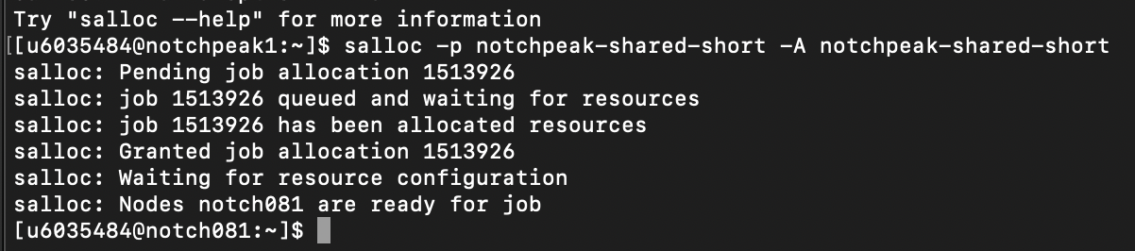
Hands On #3: Start an Interactive Job
After requesting interactive node with salloc, you saw:
Slurm grants job ID, no node granted yet
Node granted (notch081
Automatic ssh to node
- This gets around Arbiter if you have an interactive script
- This is a great way to open Rstudio sessions and other GUIs (through a FastX session).

Slide 60
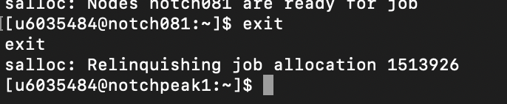
Hands On #3: Start an Interactive Job
After relinquishing the interactive node, you saw:
Job allocation revoked
Returned to login node

Slide 61
Overview of Talk
Overview
Basics of a Slurm Script
Getting Started
Example Dataset
Hands On: Batch Scripting
#1: Submitting to Notchpeak Cluster
#2: Submitting to Owner Nodes
Hands On #3: Start an Interactive Job
Hands On #4: Open OnDemand’s Job Composer

Slide 62
Open OnDemand
Open OnDemand has built-in tools available as a GUI
Great alternative for users who aren’t comfortable via command line
Notes:
Show them how this works in talk

Slide 63
Hands On #4: Open OnDemand
Navigate to ondemand.chpc.utah.edu
Go to the ‘Jobs’ menu item
Click ‘Job Composer’
Click ‘New Job’ -> ‘From Specified Path’
Input path that your Slurm script resides and submit job
Cancel the job

Slide 64
Hands On #4: Open OnDemand
Creating a job template
CHPC provides several job templates
You can create your own template
Only accessible to you
Select job that just ran
Click ‘create template’
Fill in fields
View your new Slurm template!

Slide 65
Hands On #4: Open OnDemand
Interested in learning more about Open OnDemand?
We give presentations on it every semester.
You can find slides and information here: https://www.chpc.utah.edu/presentations/OpenOnDemand.php

Slide 66
Slurm Documentation at CHPC
https://www.chpc.utah.edu/documentation/software/slurm.php
https://www.chpc.utah.edu/documentation/software/serial-jobs.php
https://www.chpc.utah.edu/documentation/software/node-sharing.php
https://www.chpc.utah.edu/usage/constraints/
https://www.chpc.utah.edu/documentation/guides/index.php#GenSlurm
Other good documentation sources
http://slurm.schedmd.com/documentation.html
http://slurm.schedmd.com/pdfs/summary.pdf
http://www.schedmd.com/slurmdocs/rosetta.pdf

Slide 67
Getting Help
CHPC website documentation
www.chpc.utah.edu
Getting started guide, cluster usage guides, software manual pages, CHPC policies
Email: helpdesk@chpc.utah.edu
Help Desk: 405 INSCC
We use chpc-hpc-users@lists.utah.edu for sending messages to users
Notes:
Will be changing to web maintenance.

